Slide 1

PROJECT Car Rental
Car Rental WEB
by Domenic Palucci and Yaoheng Mo

Slide 5
Challenges

Slide 6
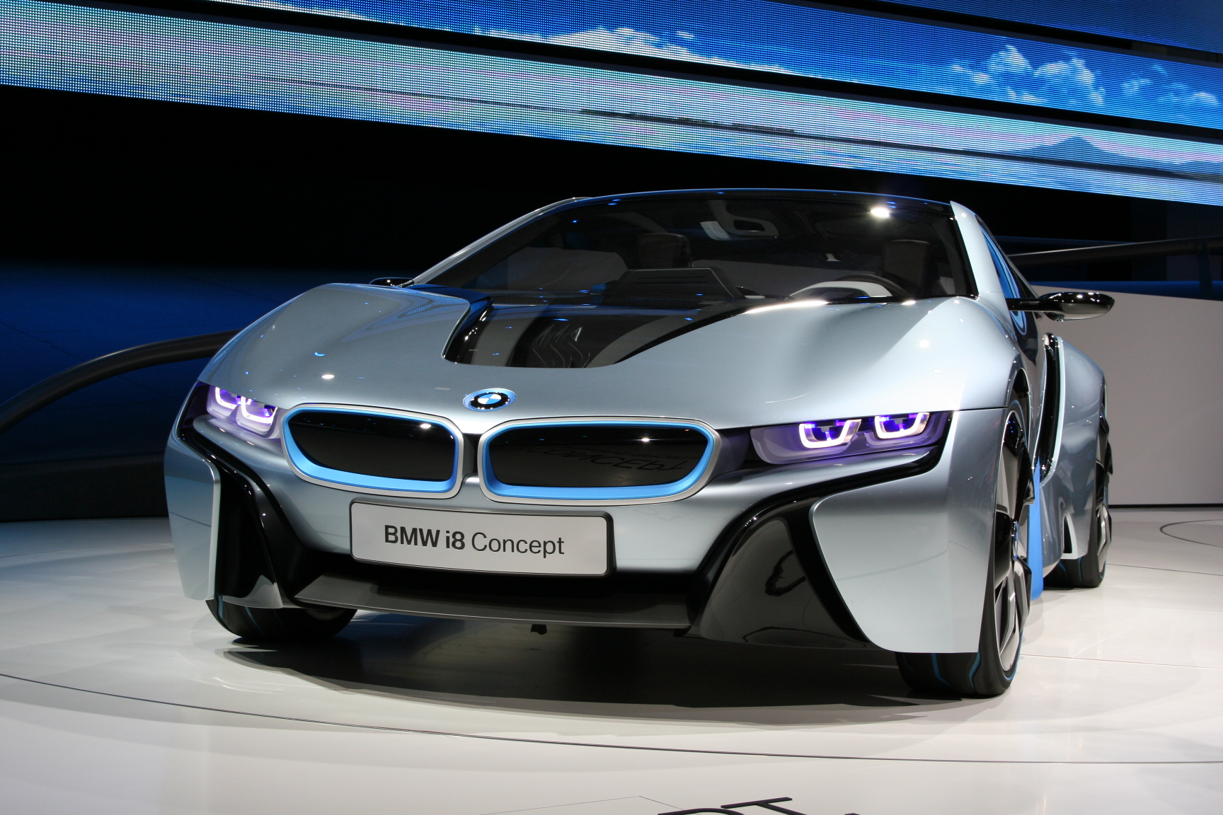

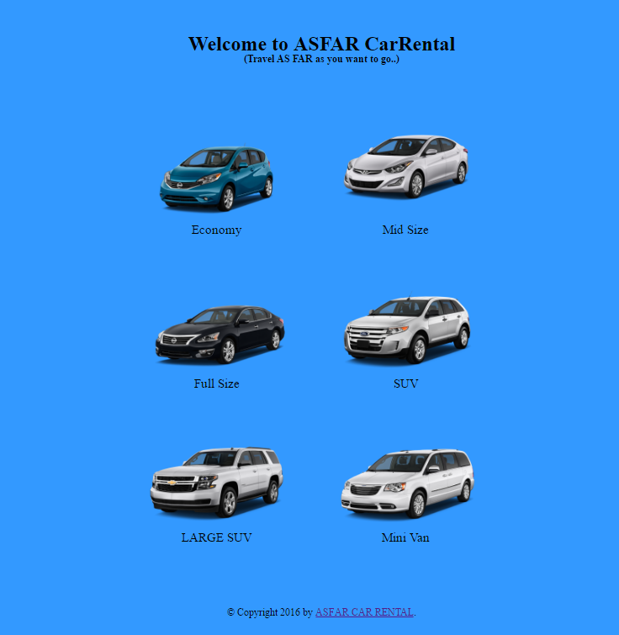
Home
Functions:
Log in
Log out
Register

Slide 7
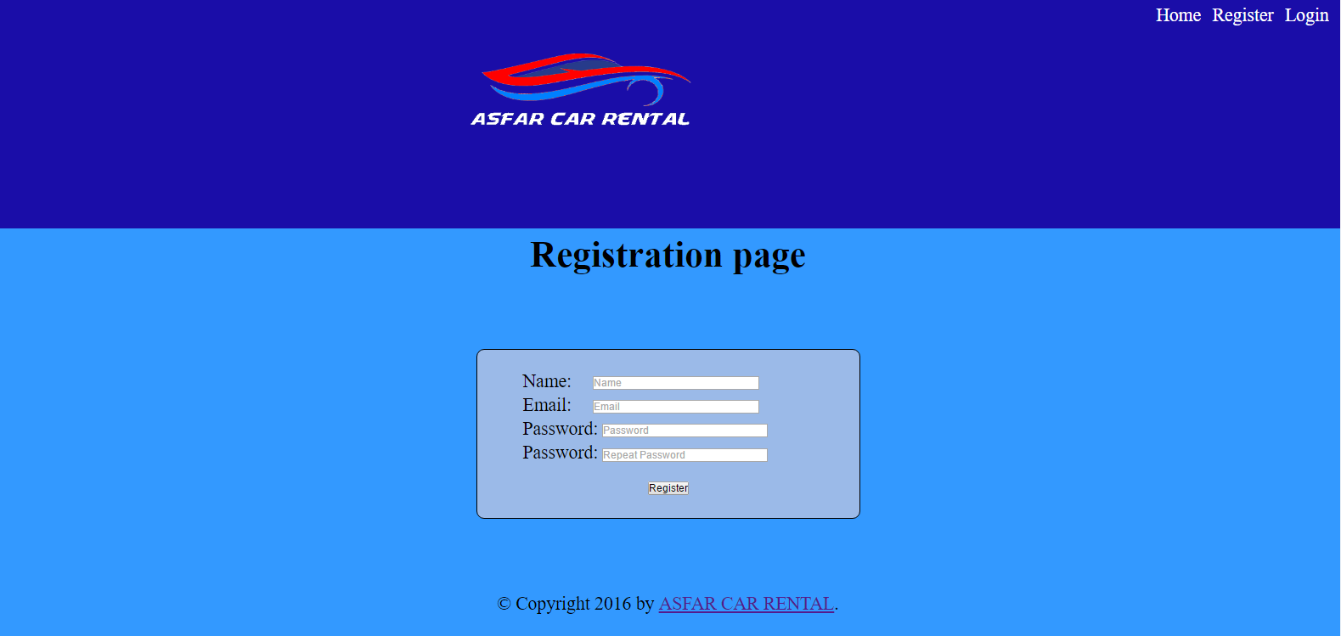
register

Slide 8
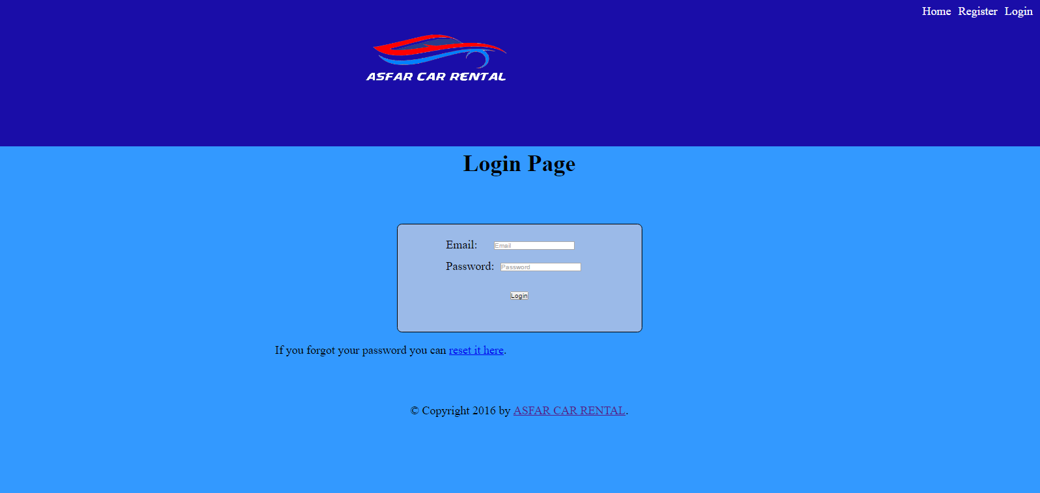
Log in

Slide 9
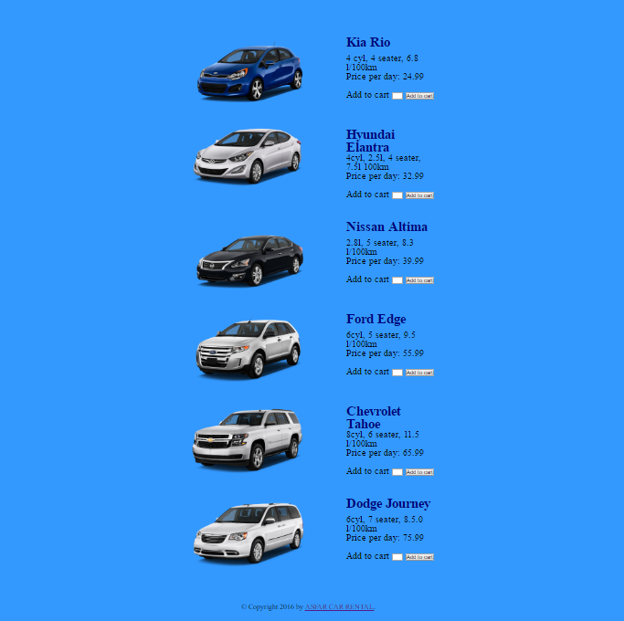
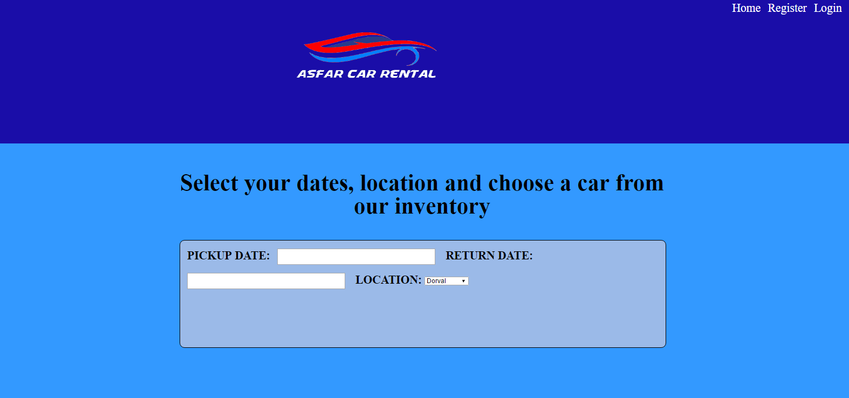
reservation

Slide 10
cart

Slide 11
validation

Slide 12
T.E.A. (Technical Educational Advancements)

Slide 13
Future Upgrades

Slide 14
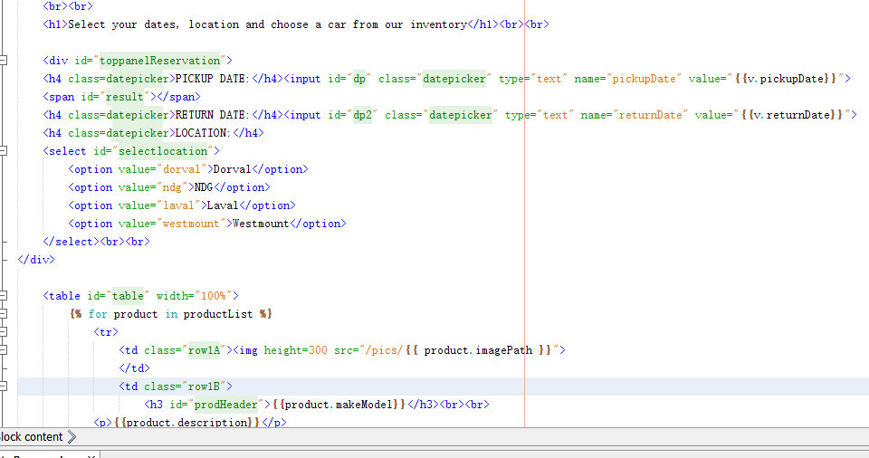

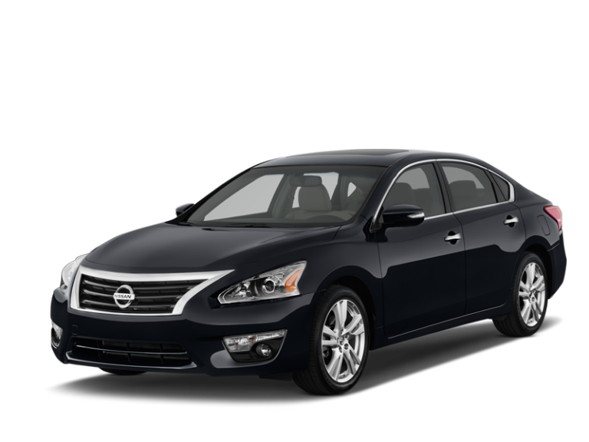
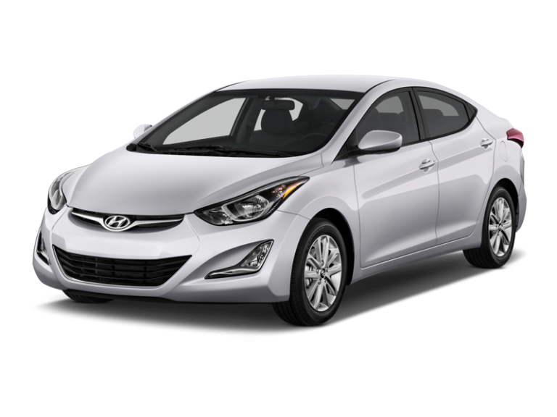

end

